Slide 1
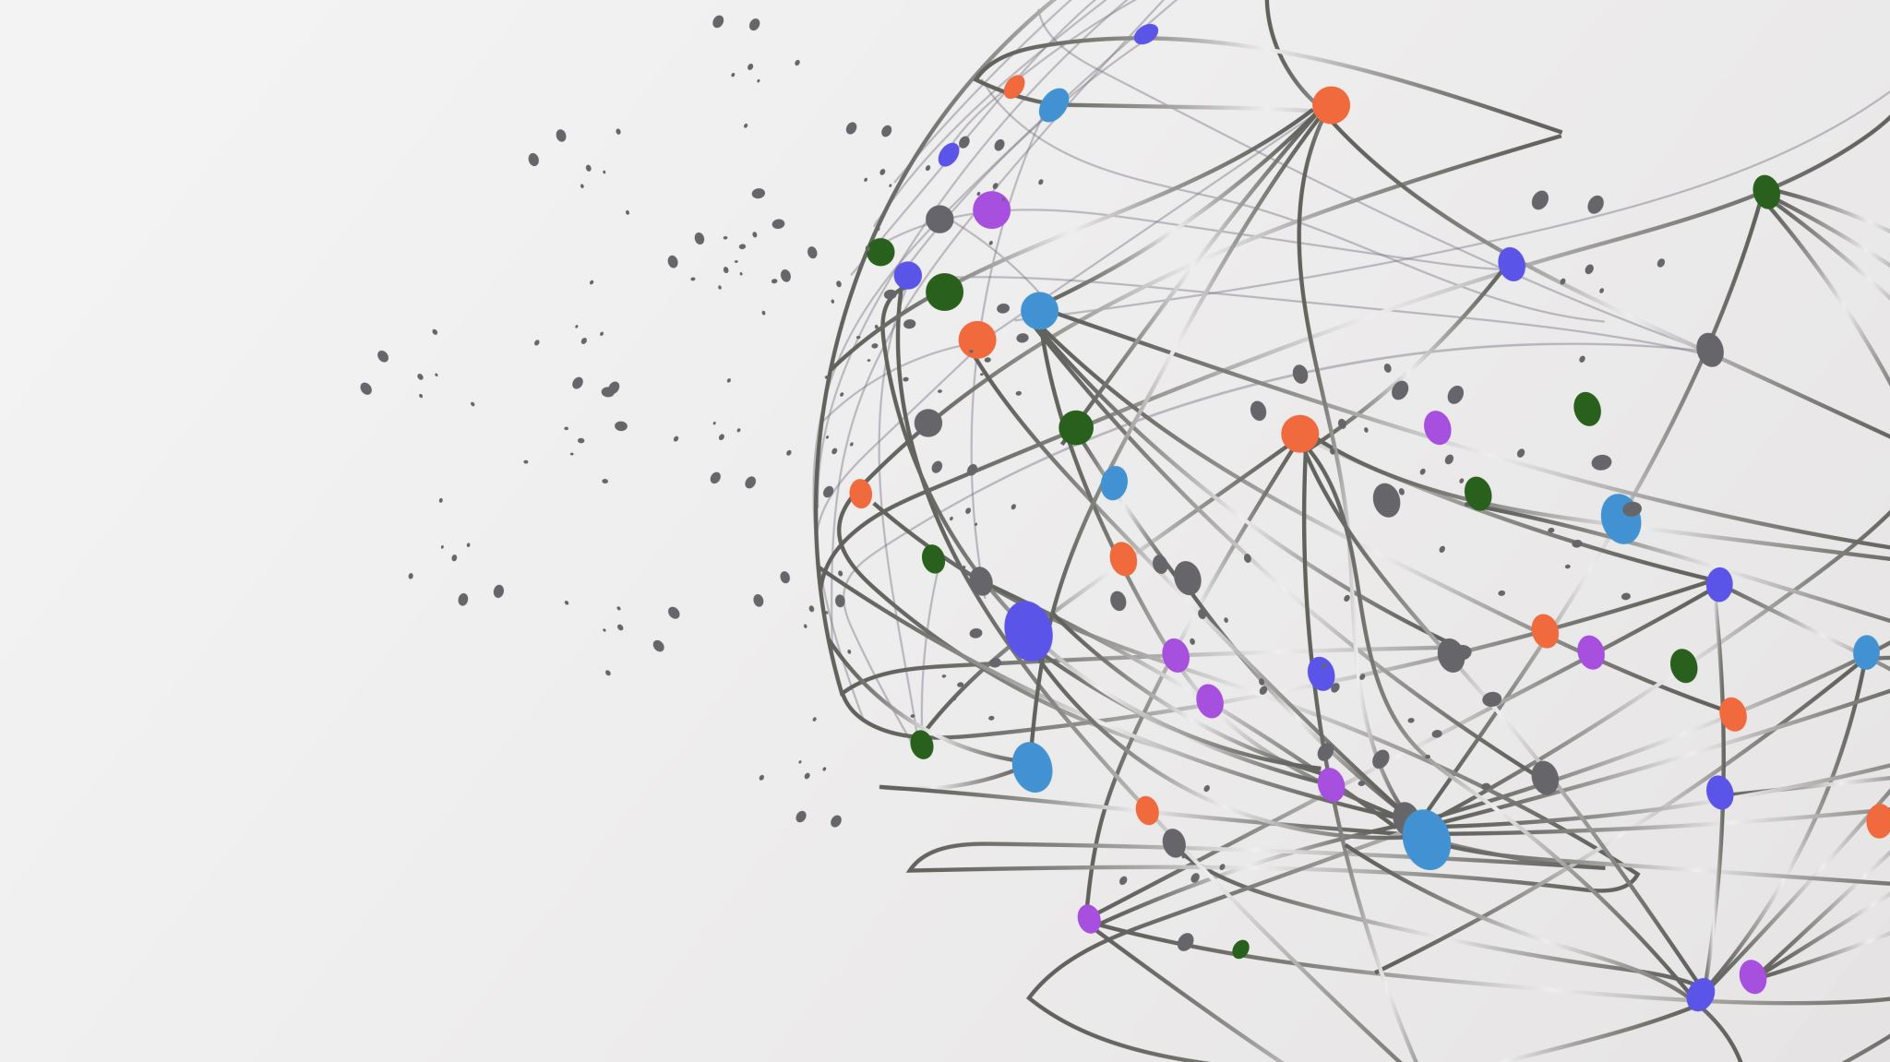
Inside Glanbia’s Supply Chain: A Multi-Layered Approach towards Sustainability
By:
Vikas Rakesh Kasera

Slide 2

Introducing
Glanbia
Dedicated towards delivering Healthy Lifestyle
Glanbia is a global nutrition company whose goal is to provide better nutrition at every stage of life. With giving importance to working together every day for the good of business, people, and the world. There work is a response to the nutritional needs of people today and their desire to live a more balanced life by making healthy choices.

Slide 3

Business Portfolio
Pure Food + Pure Planet, and driving further progress in our social and governance agendas
Brands
Value
Culture And People
Model
Growing Nutrition Market
The Power Of Brands
Science-led Innovation
Strong Portfolio And Capital Management
Sustainable Operations
Robust Balance Sheet And Strong Cash Flow
Health Sector
Resilient Supply Chain
Capital Resources
Financial Control
Quality & Risk Management
Leader In Protein & Nutritional Solutions
Performance Nutrition Brand
Cheese Producer
Weight Management Brand

Slide 4


From global uncertainty, evolving technology capability to business applications capabilities, what do you think are the biggest trends, challenges and opportunities that face the Supply Chain Management functions across Glanbia?
Trends
Challenges
Opportunities
Volatile Market Condition
Available Inventory Of Healthful Foods And Beverages
Buyer-supplier Collaboration & Acquisitions
Ecommerce Capabilities
Sustainable Supply Chain And Resilience
Influx Of Digital Technologies And Cybersecurity
Impact Of Inflation
Changing Procurement Requirement
Building Manufacturing Flexibility
Risk Management
Adjusting Market Demand
Monitoring of KPI
Stability And Market Presence In Ecommerce
Supply Chain Visibility
Incorporating Technologies for Supply Chain Efficiency
Negative fluctuations of Sourcing
R&D Advancements And Vendor Availability
Health And Safety Food Manufacturing And Increasing In-house Production.
Global Transformation Initiative Reorganizes Supply Chain And Operations.
Growing Importance Of 4 Megatrends – Globalization, Digitalization, E-commerce, And Sustainability
Targeting Net Zero By 2050
Cybersecurity Is at The Forefront Of Strategic Decision
In-house Capacity Development
Targeting Net Zero By

Slide 5




What are the implications of these environmental challenges and technology opportunities for the Supply Chain Management functions across Glanbia?
Antimicrobial packaging
Real-time capabilities
Reusable
Sustainability
Supply Chain Diversification
Eco-Friendly
Monitoring
Controlling
Quality
Safety
Bio-active
Managing
Supplier Ecosystem
Operational Integration

Slide 6






What are the implications of these environmental challenges and technology opportunities for the Supply Chain Management functions across Glanbia?
Data Privacy
Total cost of ownership
Manufacturing Techniques
Legislation
Flexibility
High Capital
Real-time tracking
Monitoring
Long-Term Consideration (Strategic Horizon)
Environmental Regulations & Standards
Data Security
Agile Approach
Government Policies

Slide 7
In this context, what actions would you recommend for the Supply Chain Function in Glanbia?
Long Term Considerations
Mitigate Risk
Drive Operational Efficiency
Stable Supply Chain
Secured Operations

Slide 8

Thank You.
Please Feel Free to Ask Questions!

